Slide 1
Bloodborne Pathogens
Notes:
1

Slide 2
Introduction
Lesson objectives:
Define bloodborne pathogens.
Identify workers who are at risk of exposure to bloodborne pathogens.
Identify key aspects of a Bloodborne Pathogen Exposure Control Plan;
Describe methods for controlling exposure to bloodborne pathogens.
Describe steps to take when exposed to a bloodborne pathogen.

Slide 3
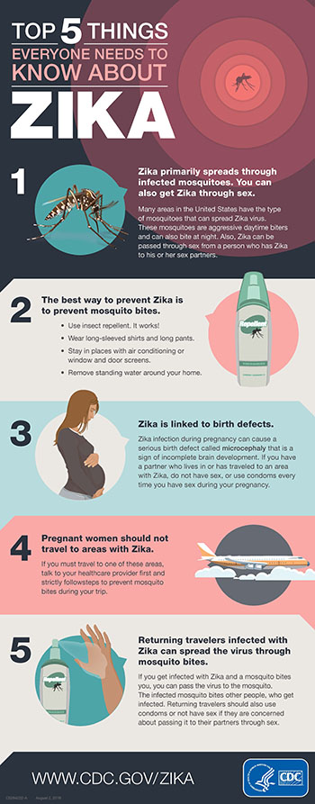
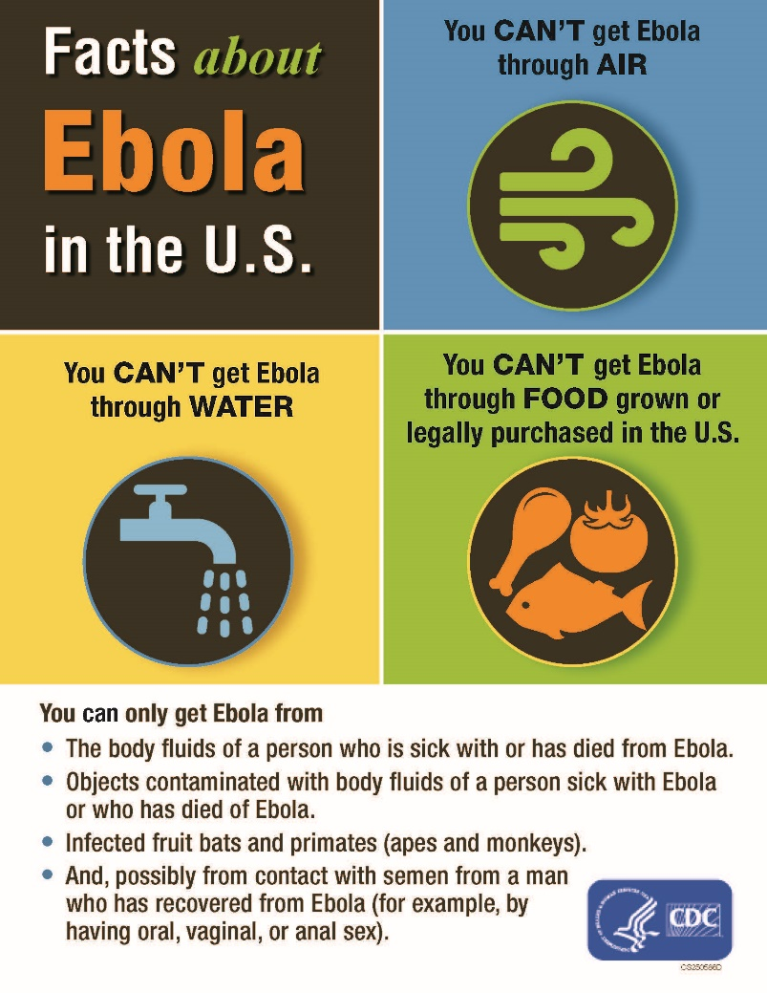
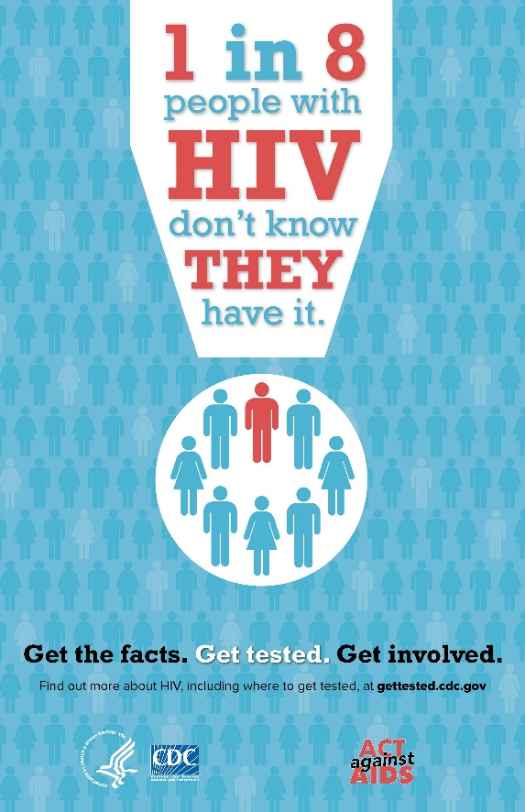
2016
2014
1981

Slide 4
Bloodborne Pathogens
What are bloodborne pathogens?
Pathogenic microorganisms present in human blood that can lead to diseases
Examples of primary concern
Hepatitis B (HBV)
Hepatitis C (HCV)
Human Immunodeficiency Virus (HIV)

Slide 5
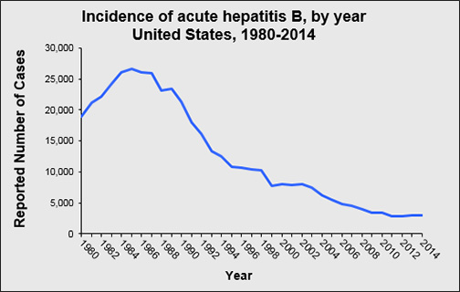
Bloodborne Pathogens
Hepatitis B (HBV)
Over 12 million Americans are infected (1 in 20)*
Silent infection; symptoms include jaundice, fatigue, abdominal pain, loss of appetite, intermittent nausea, vomiting; may lead to chronic liver disease, liver cancer, and death
HBV can survive for at least one week in dried blood
Up to 40,000 people in US will become newly infected each year*
*Source: Hepatitis B Foundation
Reported cases of hepatitis B in the U.S. have generally declined from 1980 to 2014. Source: CDC

Slide 6
Bloodborne Pathogens
Hepatitis C (HCV)
Hepatitis C is the most common chronic bloodborne infection in the U.S.
Symptoms include: jaundice, fatigue, abdominal pain, loss of appetite, intermittent nausea, vomiting
May lead to chronic liver disease and death

Slide 7
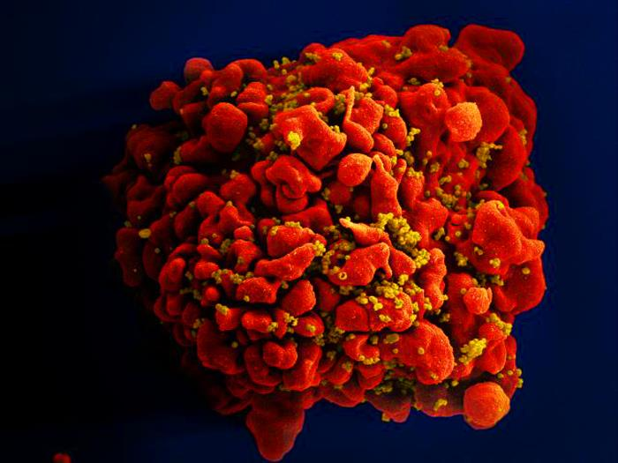
Bloodborne Pathogens
Human Immunodeficiency Virus (HIV)
HIV is the virus that leads to AIDS
HIV affects the body’s immune system
HIV does not survive well outside the body
Estimated >1.1 million people living with HIV
Infected for life
Single, red-colored H9-T cell infected by numerous mustard-colored HIV particles which are attached to the cell’s surface membrane. Source: NIAID.

Slide 8
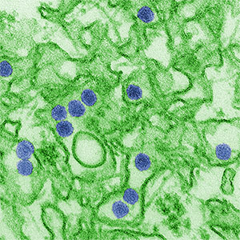
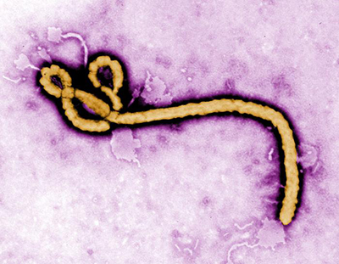
Bloodborne Pathogens
Other bloodborne diseases
Caused by viruses or bacteria
Circulate in blood at some phase; capable of being transmitted
Most are rare in the U.S.
Zika Virus (left) and Ebola Virus (right) can be spread to workers through contaminated blood or infectious body fluids.
Source: CDC / C.Goldsmith
Source: CDC / F. Murphy

Slide 9
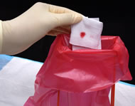
Risk of Exposure
Contamination sources:
Blood
Human body fluids
Spread of bloodborne pathogens occurs through:
Direct contact
Indirect contact
Respiratory transmission
Vector-borne transmission
Source: NIOSH

Slide 10
Risk of Exposure
How exposure occurs:
Needlesticks
Cuts from other contaminated sharps
Contact of mucous membrane or broken skin with contaminated blood
Source: OSHA DTE

Slide 11
Exposure Control Plan
HCPS has established an Exposure Control Plan
Sharepoint> Business Services> Risk Management

Slide 12
Controlling Exposures
Observe standard precautions, such as:
Treating all blood and bodily fluids as if they are contaminated
Proper cleanup and decontamination

Slide 13
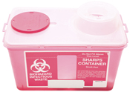
Controlling Exposures
Engineering and work practice controls:
Sharps disposal containers
Hand hygiene
Leak-proof, double-lined disposal bags
Source: NIOSH
Source: NIOSH

Slide 14
Controlling Exposures
PPE examples:
Gloves
Masks
Gowns
Available in the health suite as needed

Slide 15
Controlling Exposures
Employer’s responsibilities:
Perform hazard assessment
Identify and provide appropriate PPE to employee at no cost
Train employees on use and care
Maintain/replace PPE
Review, update, evaluate PPE program

Slide 16
Controlling Exposures
Employee’s responsibilities:
Properly wear PPE
Attend training
Notify when repairs/replacement needed
Notify if possible exposure incident has occurred.

Slide 17
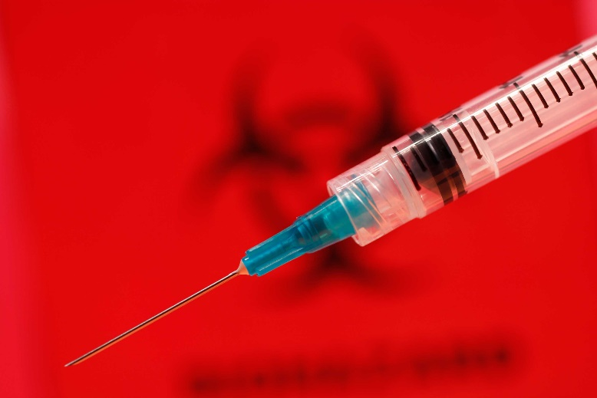
When Exposure Occurs
Exposure incident:
Specific eye, mouth, or other mucous membrane, non-intact skin, parenteral contact with blood or OPIM that results from the performance of an employee’s duties.
Source: CDC

Slide 18
When Exposure Occurs
Immediate actions
Wash exposed area with soap and water
Flush splashes to nose, mouth, or skin with water
Irrigate eyes with water and saline
Report exposure immediately
Seek treatment through healthcare professional

Slide 19
When Exposure Occurs
Confidential medical evaluation and follow-up
Route(s) of exposure and circumstances
Source individual
Collect/test blood for HBV and HIV serological status
Post exposure prophylaxis (when medically indicated)
Counseling
Evaluation

